Slide 1

Chapter 7 Part 2
Introduction to Structured Query Language (SQL)
The slides in this presentation have been adapted from slides provided with the textbook, Database Systems: Design, Implementation, and Management,
12E, Cornel and Morris, Copyright © 2017 Cengage Learning.

Slide 2
Learning Objectives
Use SQL for data manipulation (to add, modify, delete, and retrieve data)
Create and query a database using SQL
Copyright © 2017 Cengage Learning
2

Slide 3
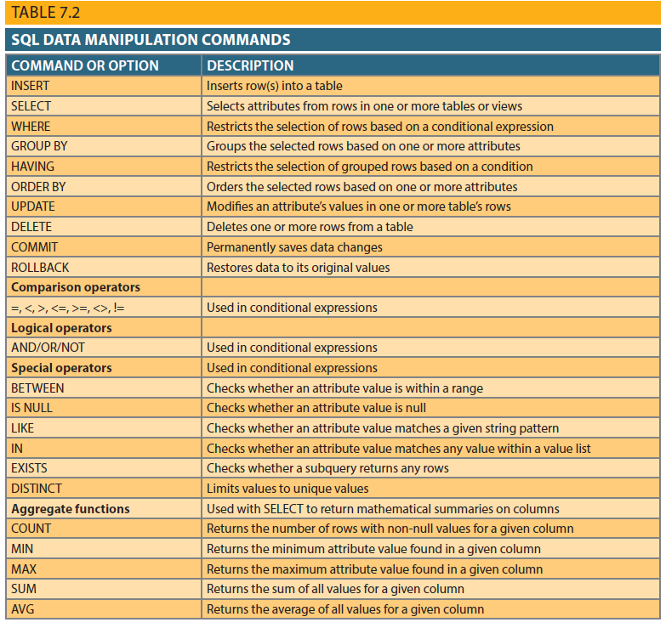
Data Manipulation Commands
INSERT
UPDATE
DELETE
COMMIT
ROLLBACK
SELECT
Copyright © 2017 Cengage Learning
3

Slide 4
Adding Table Rows
INSERT
Used to enter data into table
When entering values, notice that:
Row contents are entered between parentheses
Character and date values are entered between apostrophes
Numerical entries are not enclosed in apostrophes
Attribute entries are separated by commas
A value is required for each column
Use NULL for unknown values
Copyright © 2017 Cengage Learning
4

Slide 5
Insert Statement Example
CREATE TABLE EMP_1 (
EMP_NUM CHAR(3) PRIMARY KEY,
EMP_LNAME VARCHAR(15) NOT NULL,
EMP_FNAME VARCHAR(15) NOT NULL,
EMP_INITIAL CHAR(1),
EMP_HIREDATE DATE,
JOB_CODE CHAR(3),
FOREIGN KEY (JOB_CODE) REFERENCES JOB);
INSERT INTO EMP_1
VALUES (‘101’, ‘News’, ‘John’, ‘G’, ’08-Nov-00’, ‘502’);
INSERT INTO EMP_1
VALUES (‘102’, ‘Senior’, ‘David’, ‘H’, ’12-Jul-89’, ‘501’);
Copyright © 2017 Cengage Learning
5

Slide 6
Updating Table Rows
UPDATE
Modify data in a table
Syntax:
UPDATE tablename SET columnname = expression [, columnname = expression] [WHERE conditionlist];
If more than one attribute is to be updated in row, separate corrections with commas
Copyright © 2017 Cengage Learning
6

Slide 7
Update Statement Examples
UPDATE PRODUCT
SET P_INDATE = '18-JAN-2012'
WHERE P_CODE = '13-Q2/P2';
UPDATE PRODUCT
SET P_INDATE = '18-JAN-2012',
P_PRICE = 17.99,
P_MIN = 10
WHERE P_CODE = '13-Q2/P2';
Copyright © 2017 Cengage Learning
7

Slide 8
Deleting Table Rows
DELETE
Deletes a table row
WHERE condition is optional
If WHERE condition is not specified, all rows from specified table will be deleted
DELETE FROM PRODUCT
WHERE P_CODE = 'BRT-345';
DELETE FROM PRODUCT
WHERE P_MIN = 5;
Copyright © 2017 Cengage Learning
8

Slide 9
Inserting Table Rows with a SELECT Subquery
INSERT
Inserts multiple rows from another table (source)
Uses SELECT subquery
Subquery: query embedded (or nested or inner) inside another query
INSERT INTO PART (PART_CODE, PART_DESCRIPT, PART_PRICE, V_CODE)
SELECT P_CODE, P_DESCRIPT, P_PRICE, V_CODE
FROM PRODUCT;
Copyright © 2017 Cengage Learning
9

Slide 10
Saving Table Changes
Changes made to table contents are not physically saved on disk until:
Database is closed
Program is closed
COMMIT command is used
Syntax:
COMMIT [WORK];
Will permanently save any changes made to any table in the database
Copyright © 2017 Cengage Learning
10

Slide 11
Restoring Table Contents
ROLLBACK
Undoes changes since last COMMIT
Brings data back to prechange values
Syntax:
ROLLBACK;
COMMIT and ROLLBACK work with commands to add, modify, or delete table rows
Copyright © 2017 Cengage Learning
11

Slide 12
Listing Table Rows
SELECT
Used to list contents of table
Syntax:
SELECT columnlist
FROM tablename;
Columnlist represents one or more attributes, separated by commas
Asterisk can be used as wildcard character to list all attributes
Copyright © 2017 Cengage Learning
12

Slide 13
SELECT Queries
Fine-tune SELECT command by adding restrictions to search criteria using:
Conditional restrictions
Arithmetic operators
Logical operators
Special operators
Copyright © 2017 Cengage Learning
13

Slide 14
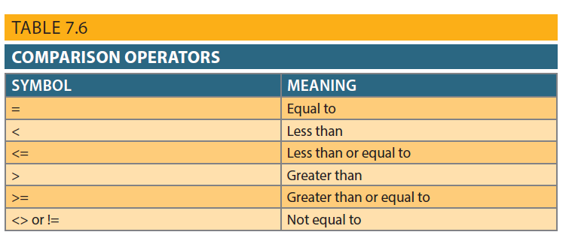
Table 7.6 - Comparison Operators
Copyright © 2017 Cengage Learning
14

Slide 15
Selecting Rows with Conditional Restrictions
Select partial table contents by placing restrictions on rows to be included in output
Add conditional restrictions to SELECT statement, using WHERE clause
Syntax:
SELECT columnlist FROM tablelist [ WHERE conditionlist ] ;
Copyright © 2017 Cengage Learning
15

Slide 16
Where Clause Examples
SELECT P_DESCRIPT, P_INDATE, P_PRICE, V_CODE
FROM PRODUCT
WHERE V_CODE = 21344;
SELECT P_DESCRIPT, P_INDATE, P_PRICE, V_CODE
FROM PRODUCT
WHERE V_CODE < > 21344;
SELECT P_DESCRIPT, P_QOH, P_MIN, P_PRICE
FROM PRODUCT
WHERE P_PRICE <= 10;
SELECT P_CODE, P_DESCRIPT, P_QOH, P_MIN, P_PRICE
FROM PRODUCT
WHERE P_CODE < '1558-QW1';
Copyright © 2017 Cengage Learning
16

Slide 17
Selecting Rows with Conditional Restrictions (cont’d.)
Using comparison operators on dates
Date procedures are often more software-specific than other SQL procedures
Using computed columns and column aliases
SQL accepts any valid expressions (or formulas) in the computed columns
Alias
Alternate name given to a column or table in any SQL statement
Copyright © 2017 Cengage Learning
17

Slide 18
Dates and Derived Attributes
SELECT P_DESCRIPT, P_QOH, P_MIN, P_PRICE, P_INDATE
FROM PRODUCT
WHERE P_INDATE >= '20-JAN-2012';
SELECT P_CODE, P_INDATE, SYSDATE - 90 AS CUTDATE
FROM PRODUCT
WHERE P_INDATE <= SYSDATE - 90;
SELECT P_CODE, P_INDATE, P_INDATE + 90 AS EXPDATE
FROM PRODUCT;
SELECT P_DESCRIPT, P_QOH, P_PRICE, P_QOH*P_PRICE AS TOTAL_VALUE
FROM PRODUCT;
Copyright © 2017 Cengage Learning
18

Slide 19
Select Invoice Statement
SELECT
INVOICE.CUS_CODE,
INVOICE.INV_NUMBER,
PRODUCT.P_DESCRIPT,
LINE.LINE_UNITS AS [Units Bought],
LINE.LINE_PRICE AS [Unit Price],
LINE.LINE_UNITS*LINE.LINE_PRICE AS Subtotal
FROM CUSTOMER, INVOICE, LINE, PRODUCT
WHERE CUSTOMER.CUS_CODE = INVOICE.CUS_CODE
AND INVOICE.INV_NUMBER = LINE.INV_NUMBER
AND PRODUCT.P_CODE = LINE.P_CODE
ORDER BY INVOICE.CUS_CODE, INVOICE.INV_NUMBER, PRODUCT.P_DESCRIPT;
Copyright © 2017 Cengage Learning
19

Slide 20
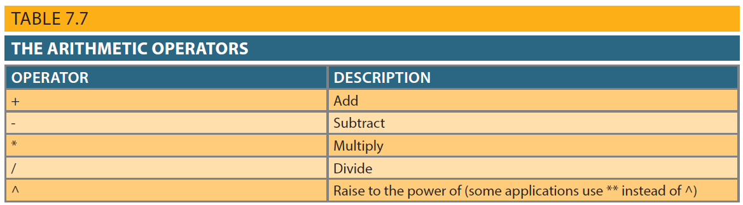
Arithmetic Operators: The Rule of Precedence
Perform operations within parentheses
Perform power operations
Perform multiplications and divisions
Perform additions and subtractions
Copyright © 2017 Cengage Learning
20

Slide 21
Logical Operators: AND, OR, and NOT
Searching data involves multiple conditions
Logical operators: AND, OR, and NOT
Can be combined
Parentheses enforce precedence order
Conditions in parentheses are always executed first
Boolean algebra: mathematical field dedicated to use of logical operators
NOT negates result of conditional expression
Copyright © 2017 Cengage Learning
21

Slide 22
Logical Operators Examples
SELECT P_DESCRIPT, P_INDATE, P_PRICE, V_CODE
FROM PRODUCT
WHERE V_CODE = 21344 OR V_CODE = 24288;
SELECT P_DESCRIPT, P_INDATE, P_PRICE, V_CODE
FROM PRODUCT
WHERE P_PRICE < 50 AND P_INDATE > '15-JAN-2012';
SELECT P_DESCRIPT, P_INDATE, P_PRICE, V_CODE
FROM PRODUCT
WHERE (P_PRICE < 50 AND P_INDATE > '15-JAN-2012') OR V_CODE = 24288;
SELECT *
FROM PRODUCT
WHERE NOT (V_CODE = 21344);
Copyright © 2017 Cengage Learning
22

Slide 23
Special Operators
BETWEEN: checks whether attribute value is within a range
IS NULL: checks whether attribute value is null
LIKE: checks whether attribute value matches given string pattern
IN: checks whether attribute value matches any value within a value list
EXISTS: checks if subquery returns any rows
Copyright © 2017 Cengage Learning
23

Slide 24
Special Operators Examples
SELECT * FROM PRODUCT
WHERE P_PRICE BETWEEN 50.00 AND 100.00;
SELECT P_CODE, P_DESCRIPT, V_COCE FROM PRODUCT
WHERE V_CODE IS NULL;
SELECT V_NAME, V_CONTACT, V_AREACODE, V_PHONE
FROM VENDOR
WHERE V_CONTACT LIKE 'Smith%';
SELECT *
FROM PRODUCT
WHERE V_CODE IN (21344, 24288);
Copyright © 2017 Cengage Learning
24

Slide 25
Select statement w/ subquery (custs w/no invoices)
SELECT
SUM(CUS_BALANCE) AS [Total Balance],
MIN(CUS_BALANCE) AS [Minimum Balance],
MAX(CUS_BALANCE) AS [Maximum Balance],
AVG(CUS_BALANCE) AS [Average Balance]
FROM
( SELECT CUS_CODE, CUS_BALANCE
FROM CUSTOMER
WHERE CUSTOMER.CUS_CODE NOT IN
(SELECT DISTINCT CUS_CODE
FROM INVOICE) );
Copyright © 2017 Cengage Learning
25

Slide 26
Virtual Tables: Creating a View
View is virtual table based on SELECT query
Create view by using CREATE VIEW command
Special characteristics of relational view:
Name of view can be used anywhere a table name is expected
View dynamically updated
Restricts users to only specified columns and rows
Views may be used as basis for reports
Copyright © 2017 Cengage Learning
26

Slide 27
Create View Statement
CREATE VIEW INVOICES AS
SELECT
INVOICE.CUS_CODE,
INVOICE.INV_NUMBER,
PRODUCT.P_DESCRIPT,
LINE.LINE_UNITS AS [Units Bought],
LINE.LINE_PRICE AS [Unit Price],
LINE.LINE_UNITS*LINE.LINE_PRICE AS Subtotal
FROM CUSTOMER, INVOICE, LINE, PRODUCT
WHERE CUSTOMER.CUS_CODE = INVOICE.CUS_CODE
AND INVOICE.INV_NUMBER = LINE.INV_NUMBER
AND PRODUCT.P_CODE = LINE.P_CODE
ORDER BY INVOICE.CUS_CODE, iNVOICE.INV_NUMBER, PRODUCT.P_DESCRIPT;
Copyright © 2017 Cengage Learning
27

Slide 28
Additional SELECT Query Keywords
Logical operators work well in the query environment
SQL provides useful functions that:
Count
Find minimum and maximum values
Calculate averages, etc.
SQL allows user to limit queries to:
Entries having no duplicates
Entries whose duplicates may be grouped
Copyright © 2017 Cengage Learning
28

Slide 29
Summary
DML commands allow you to add, modify, and delete rows from tables
The basic DML commands:
SELECT, INSERT, UPDATE, DELETE, COMMIT, and ROLLBACK
SELECT statement is main data retrieval command in SQL
WHERE clause can be used with SELECT, UPDATE, and DELETE statements
Copyright © 2017 Cengage Learning
29

Slide 30
Task
Write a SELECT query to find all employees with a last name of Smith.
Copyright © 2017 Cengage Learning
30

